Slide 1

Update on NHS LFS Screening Protocol
Dr Helen Hanson
Consultant and Joint Lead for Cancer Genetics
South West Thames Regional Genetics Service
St Georges University Hospital

Slide 2
Background : Screening recommendations in LFS
LFS predisposes to a high lifetime risk of multiple cancers
Screening in UK has been limited
Increasing literature demonstrating early cancer detection through more comprehensive screening
  SIGNIFY (UK)
  Toronto protocol Villani et al. Lancet Oncol 2011 and 2016
  Meta-analysis of baseline surveillance with WB-MRI in Li-Fraumeni syndrome. Ballinger et al. JAMA Oncology 2017
UK Consensus meeting arranged 6th July 2018

Slide 3


UK Consensus Meeting –6th July 2018
Aspiration for consistent UK approach –meeting convened 6th July by UK CGG
43 attendees –Clinical Genetics, Paeds Oncology, Radiology, Patients
3 discussion groups –mixed specialties – 3 sessions
What?
What screening should we recommend
Where?
Local v national?
Who?
Adults /Children
Confirmed carriers only?

Slide 4
UK Consensus Group Recommendations
Tumour | Screening recommendation
ACC | Abdominal USS 3-4 monthly birth-18 years Biochemistry (17 OH-progesterone, total testosterone, DHEAS, androstenedione) should only be performed where there is an unsatisfactory USS
Breast Cancer | Annual dedicated MRI from age 20-70 (As per NHSBSP 74) Consider risk reducing mastectomy from age 20
Brain tumour | Annual dedicated brain MRI from birth (first MRI with contrast)*
Sarcoma | Annual WB-MRI from birth*
Haematological | Not indicated due to lack of evidence
Colon | Colonoscopy only indicated when family history of colorectal cancer or polyposis. Consider other, possibly co-inherited, causes as appropriate.
Gastric | Recommend Helicobacter pylori testing and eradication if required Endoscopy not indicated due to lack of evidence
Skin | Annual dermatology review from 18yrs (GP or Dermatology)
Physical examination | Full physical examination 3-4 monthly in children (including blood pressure, anthropometric measurements, signs of virilisation and neurological exam) Routine physical examination not recommended in adults – advise detailed discussion of “red flag” symptoms and low threshold for fast track referral of persistent or unusual symptoms
Other | Recommend detailed discussion of “red flag” symptoms in both children and adults and provide information on relevant resources

Slide 5
Red flag warnings: https://www.tp53.co.uk/red-flags/
Headache – persistent and often worse in the morning
Nausea or vomiting, particularly in the morning
Unsteady when walking, poor coordination
Drooling and/or difficulty swallowing
Loss of appetite (weight loss)
Slurred speech
Seizures (any type)
Changes in vision or abnormal eye movements
Personality change
Excessive bruising (bleeding)
Bumps or lumps that appear with no explanation or apparent cause and which do not shrink and disappear
Joint pain or swelling around joints (children should not have back pain or hip/pelvic pain without a clear reason/injury – and should get better within a short time)
Swollen tummy and/or persistent constipation (new symptoms)
Signs of puberty appearing early (infants / any child under 10-years old developing acne, hair growth, redness of the face (Cushingoid appearance) and weight gain)

Slide 6


Slide 7
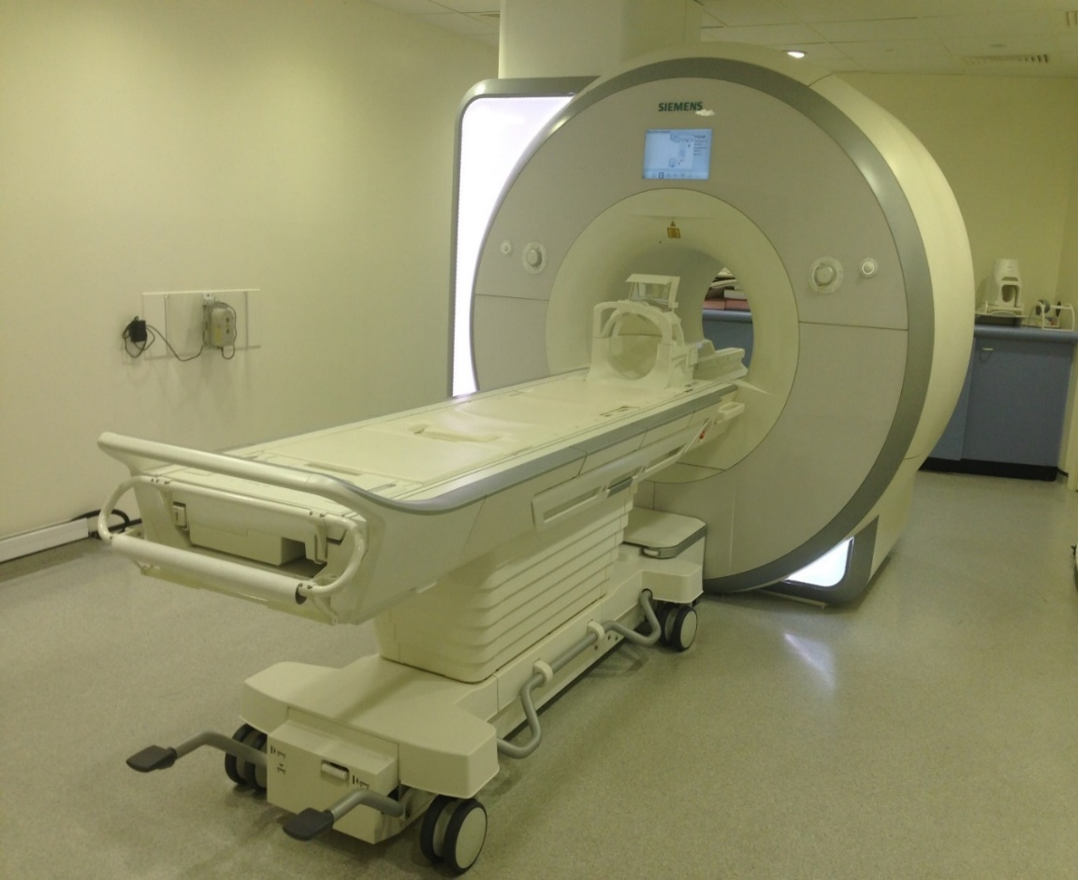
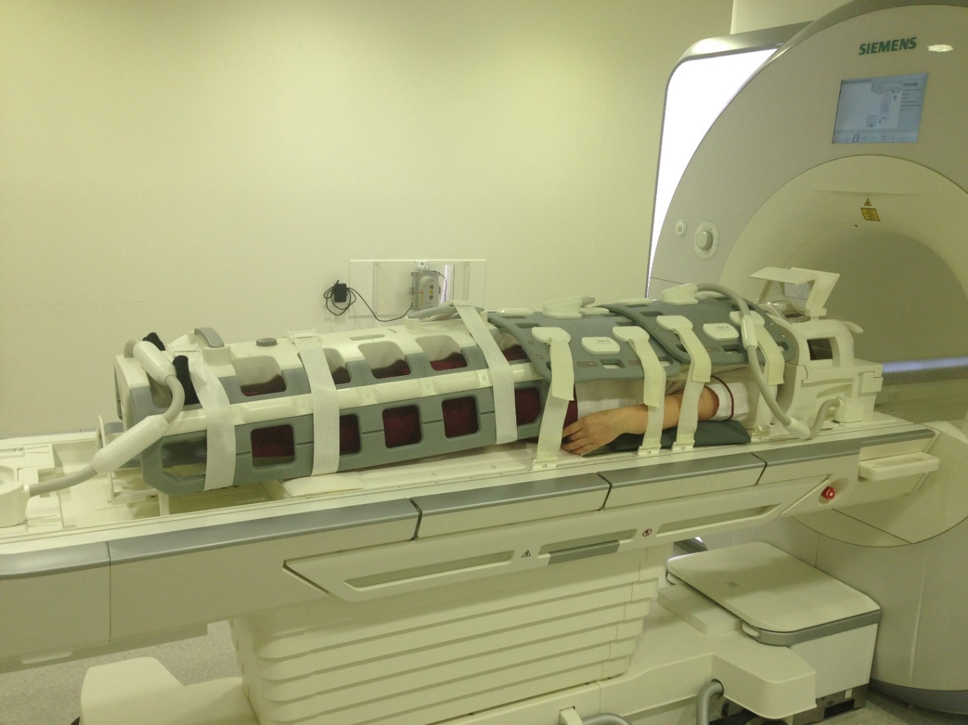
Barriers to implementation of WBMRI
MRI scanners
Radiology expertise
Radiology capacity
Funding source

Slide 8
Pathway so far…..
2018-2019: Discussion NHSE Specialised Commissioning
  Advised to put in application for PPP for annual WB-MRI and brain MRI
  First step approval by Medical Genetics CRG (Clinical Reference Group)
  Discussed October 2018 –agreed to support, pending review by Public Health
  Re-reviewed March 2019 (*CRG disbanded early 2019, only recently reconvened)
Specialised commissioning will not support national funding
  Reasoning largely that do not fund screening for other cancer predisposition syndromes
  NHSE can make a policy statement advising as best practice/standard of care, but funding will need to be sought locally
  Suggested that undertake further discussion with Higher Specialised Commissioning

Slide 9
Pathway so far…..
2019-2020
  Taken over by Dr Ayesha Ali-NHSE Highly Specialised Services
Paper was presented Rare Diseases Advisory Group (RDAG) in July 2020 for their view and support on next steps
Aim to more effectively signpost patients to trusts that can undertake scanning, reimburse them for this activity and establish specific reporting arrangements.
Not a proposal for a separate service or an addition to the national screening programmes but a more pragmatic approach to build on existing infrastructure and arrangements.
Notes:
Highly specialised services are provided to a smaller number of patients compared to specialised services; usually no more than 500 patients per year. For this reason they are typically best delivered nationally through a very small number of centres of excellence.

Slide 10
Pathway so far…..
Discussed with Specialised Commissioning Senior Management Team to present some options for addressing the problem and eliciting their support and consideration for central funding
Submitted for national funding (for which there were numerous bids) and this project was not selected
Waiting to see whether additional funding can be found for the bids that were not prioritised
NHSE agreement that SOC
  Issue on ground is that this has resulted in “postcode lottery” and no centralisation of radiology and reporting.

Slide 11
Conflicting factors
Change in staff/processes in NHSE Specialised Commissioning
Disbanding of Medical Genetics CRG/ huge reconfiguration of Genetics services -priority for NHSE
COVID….

Slide 12
What has been happening locally?
Increasing numbers of centres have been able to offer WB-MRI particularly where small numbers of patients and Radiology departments have expertise and capacity
Some patients have been able to access WB-MRI outside local area funded by local Trust/CCG
Large number of Genetics centres currently unable to offer

Slide 13
What further can be done?
Continued discussions with NHSE
MILI study
Patient voices

Slide 14
Other updates

Slide 15
Whole genome sequencing
Paediatric cancer
Sarcoma
Haematological malignancies

Slide 16
Discussion

