Slide 1


Liquid Biopsies-
Current State and Future Prospects
Kenny Rankin
Honorary Consultant in Orthopaedic Oncology
07/09/19

Slide 2
Overview
Liquid biopsy – meaning and history
Uses for liquid biopsy
Current state
Future prospects

Slide 3
Liquid biopsy
Blood sample
  Easy to take
Measure a ‘marker’
  Screen for cancer
  Guide treatment
  Early warning of relapse
First reports of Circulating tumour cells were in 1869!
Ashworth TR. A case of cancer in which cells similar to those in the tumours were seen in the blood after death. Med J Australia 1869;14:146–7

Slide 4
Gradual technological advances
Many techniques described to isolate CTCs
Varying success in carcinoma
Sarcoma literature is slowly catching up
Important to remember that there are many circulating biomarkers to consider measuring

Slide 5
MARKERS FOR BONE SARCOMA
Nucleic acids:
MicroRNAs
Circulating tumour DNA
Novel proteins and metabolites:
Proteomics, metabolomics
Intact circulating tumour and endothelial cells
Specific
Less specific
Non specific:
C-RP, ESR, LDH
Tumour turnover:
Alk Phos, Chondroitin sulphate
Disease specific proteins:
Galactin-3

Slide 6
Non specific markers (bone sarcoma)
Readily Available Biomarkers:
  C-Reactive protein (not disease specific)
  Erythrocyte sedimentation rate (not disease specific)
  Alkaline phosphatase (bone turnover)
79 patients assessed

Slide 7
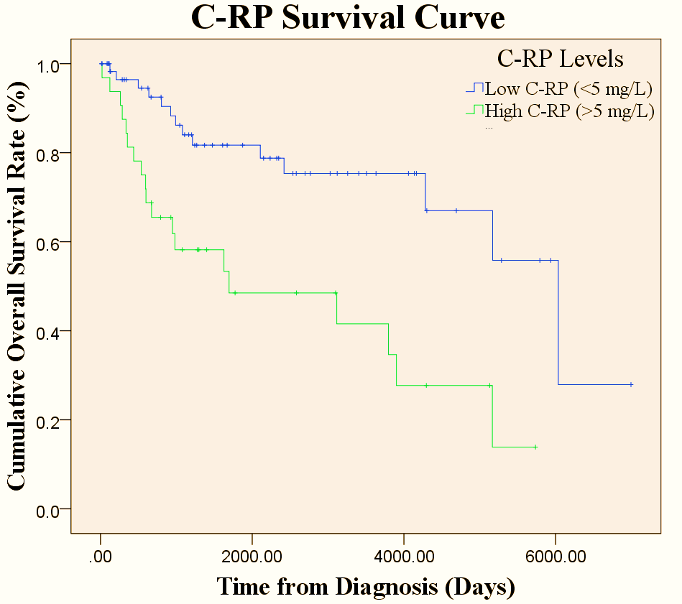
High C-RP- taken as over 5mg/ml correlates with decreased survival.
P<0.01

Slide 8
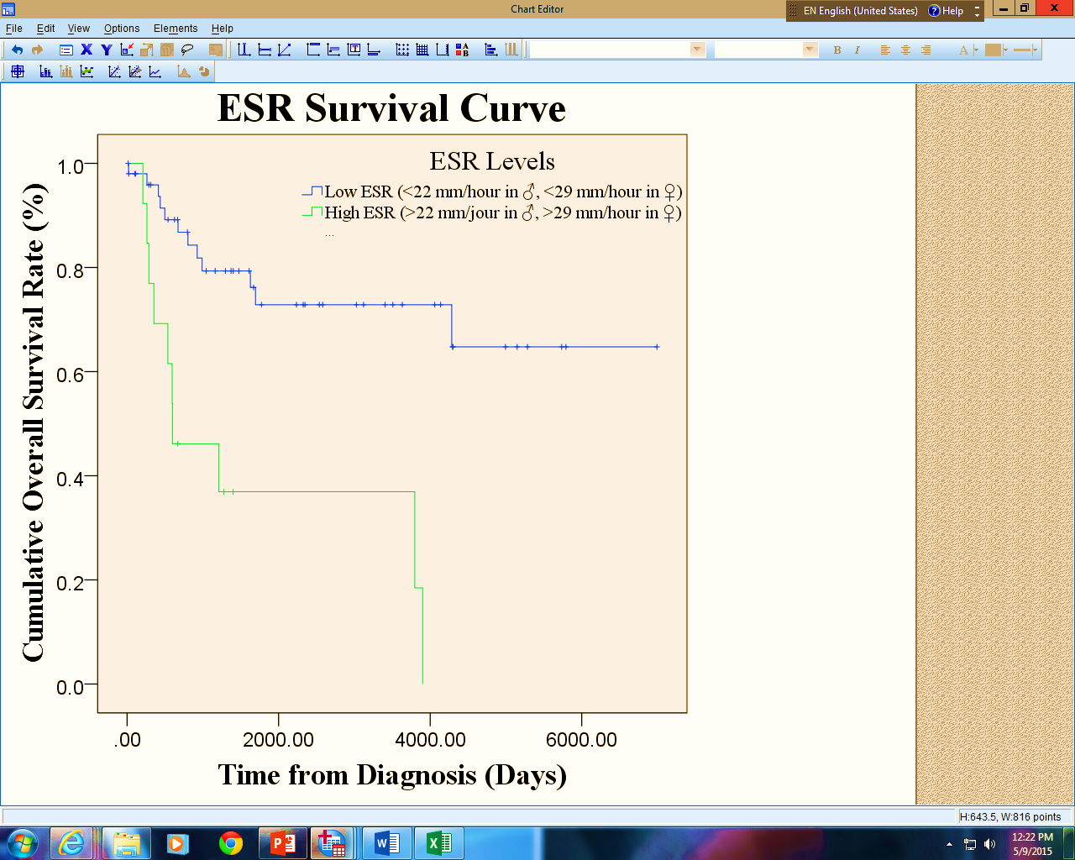
High ESR was taken at over 22mm/hour in males and 29mm/hour in females
Increased ESR correlated with decreased survival at p<0.01

Slide 9
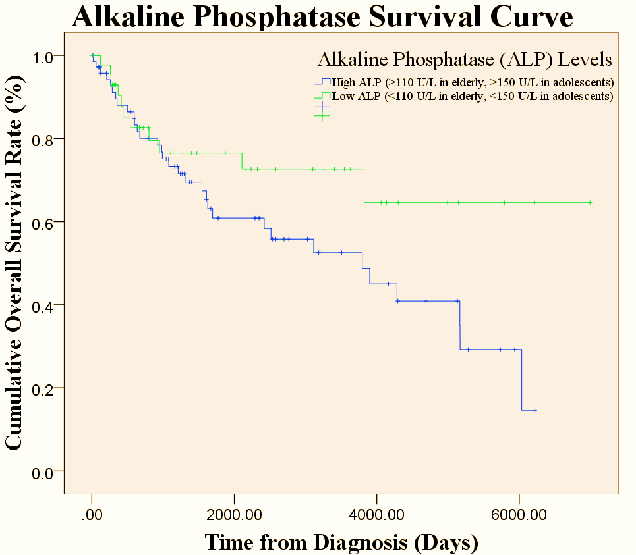
High Alk Phos taken as over 110 in adults and over 150 in children i.e. 18 years and over
Increased Alk Phos levels correlated with decreased survival at p=0.024

Slide 10
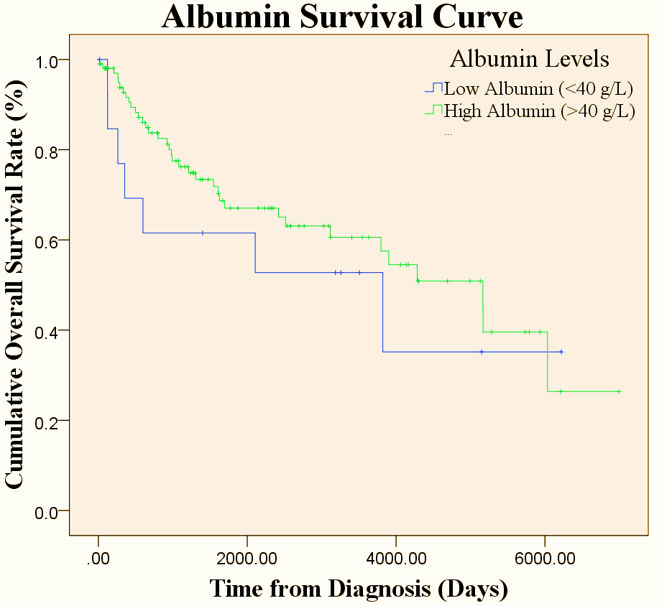
There was no correlation of Albumin levels with survival (p=0.398)

Slide 11
Detection of intact tumour cells
Numerous reports regarding carcinoma
  CTC numbers can correlate with disease burden
  Genomic analysis of retained CTCs reflects disease status
  Does not routinely influence treatment decisions
  Still reliant on EpCAM and cytokeratins for detection
Techniques
  Detection only
  Detection and retention

Slide 12
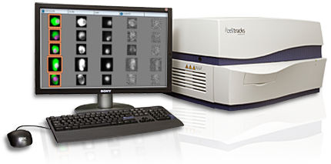
Cell Search system
Immunomagnetic detection
EpCAM and cytokeratins
Exclusion of CD45 +ve cells
Definite CTCs: CD45 –ve and EpCAM/CK +ve
Suspicious cells: CD45-ve and EpCAM/CK -ve

Slide 13
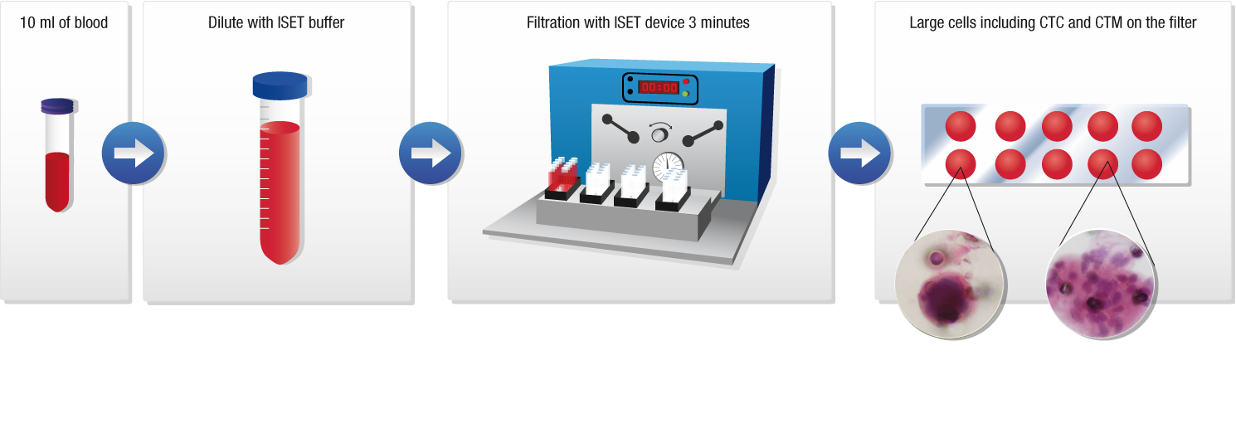
Isolation by Size Exclusion Technique

Slide 14
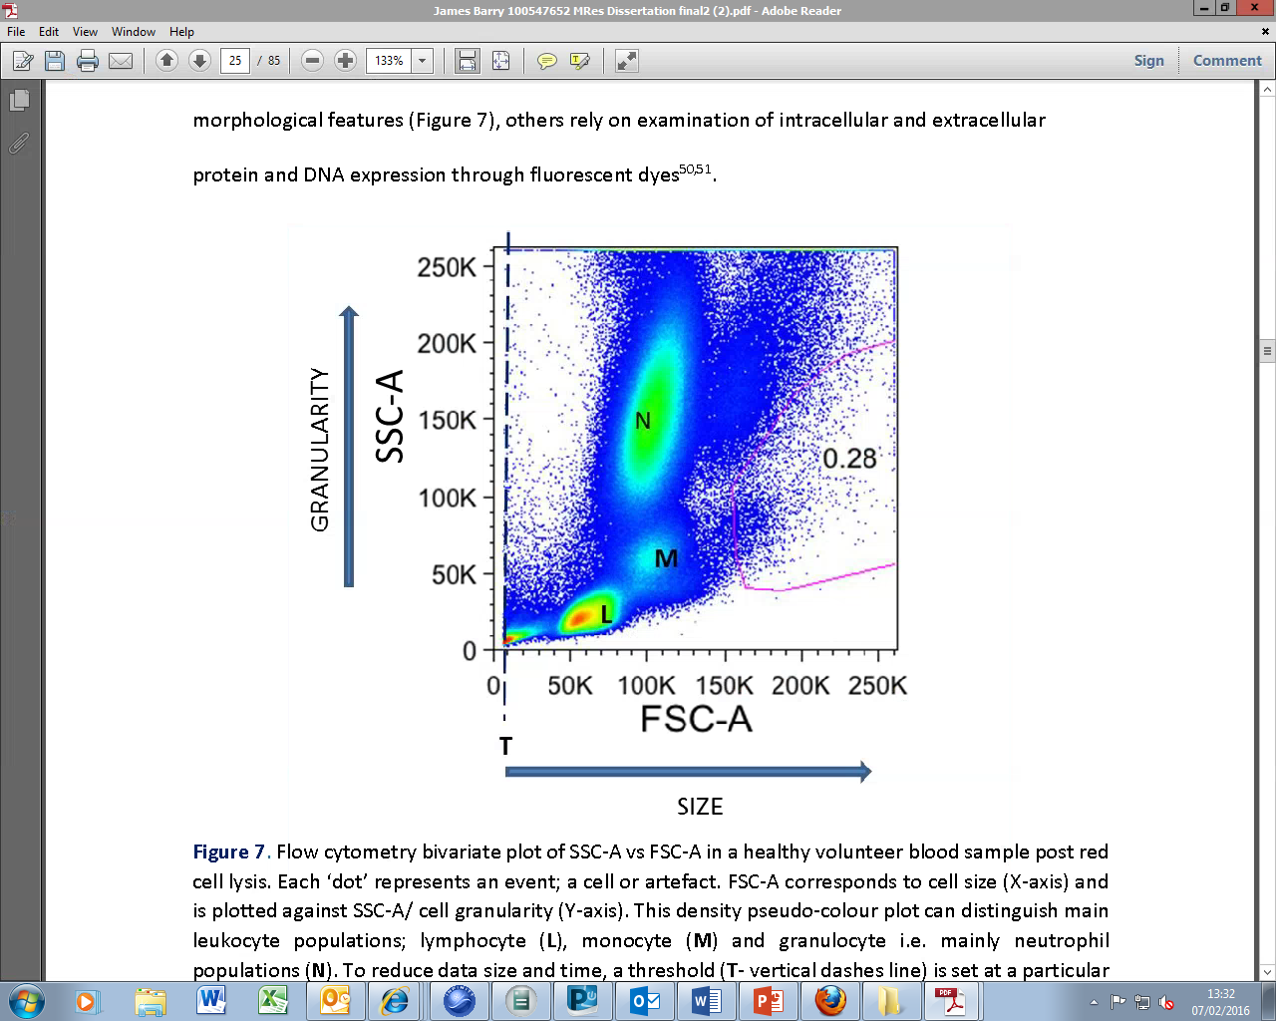
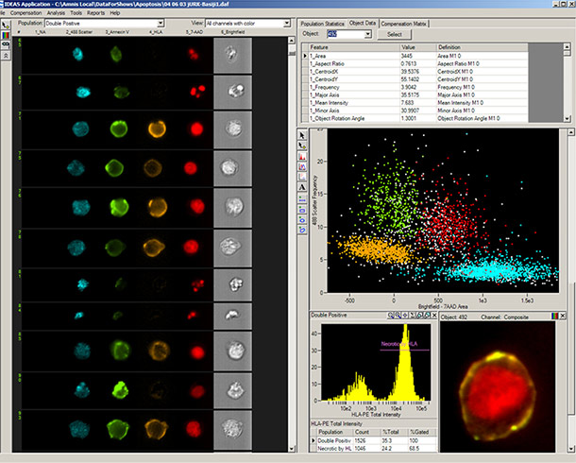
Basic flow cytometry
Imagestream flow cytometer

Slide 15
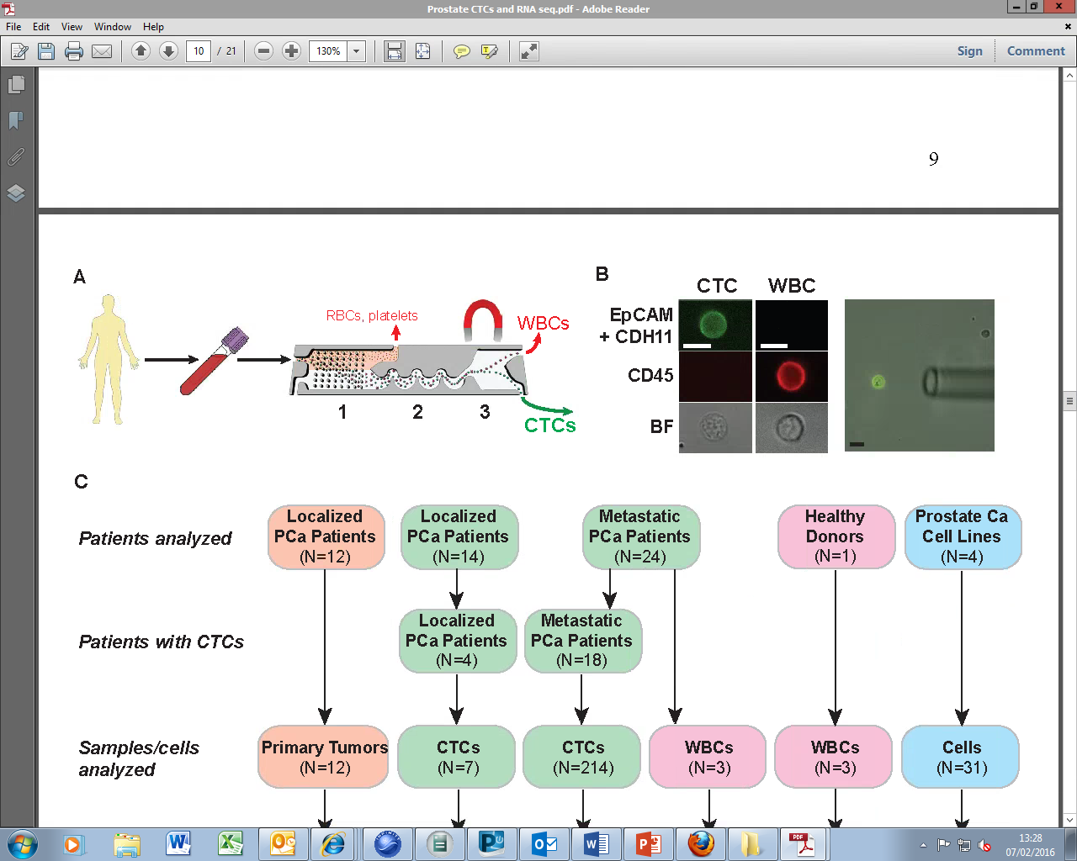
Microfluidics- CTC iChip
RBCs and platelets removed by size exclusion then WBCs removed by magnetic depletion

Slide 16
Advantages and disadvantages
ISET- cheap hardware but labour intensive
Flow cytometry- cheap but concerns around CTC destruction
Microfluidics- expensive
Cell Search- designed for carcinoma
All suffer from lack of robust biomarkers

Slide 17
CTCs unknowns
Are CTCs released into the circulation in a steady state?
Is there diurnal variation in numbers?
Do CTCs form clusters with each other and/or white cells?
Are CTCs in large numbers in some patients simply due to anatomical reasons i.e. tumour happens to be in close proximity to a large blood vessel
Do CTCs reside in the marrow in many cancers?

Slide 18
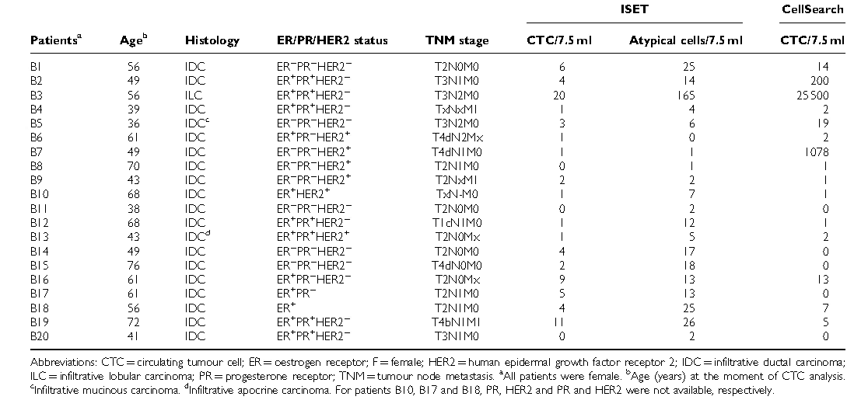

Slide 19
BONE
OS Cell
Osteoblast
MT1-MMP
Stem cell
Blood vessel
Basement
membrane
MT1-MMP
TIMP-2
proMMP-2
MMP-2
Blood vessel

Slide 20
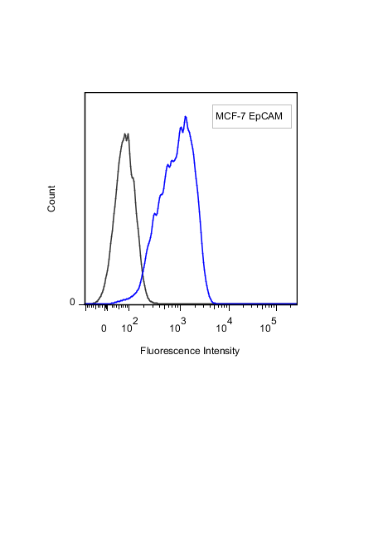
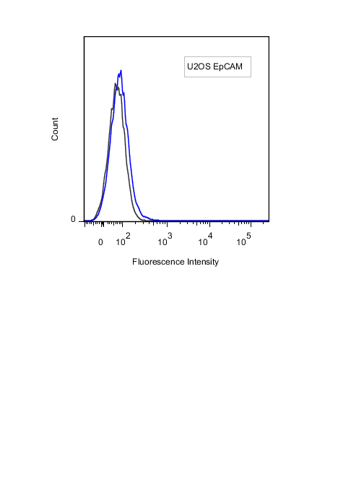
Biomarker validation
Breast carcinoma cell line
Osteosarcoma cell line

Slide 21
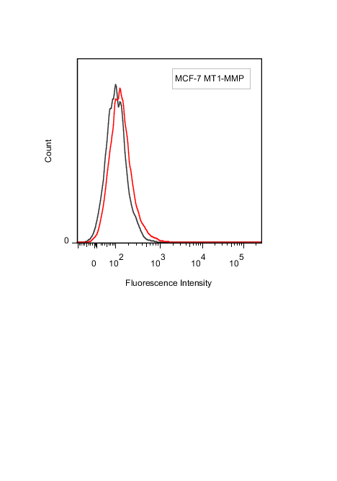
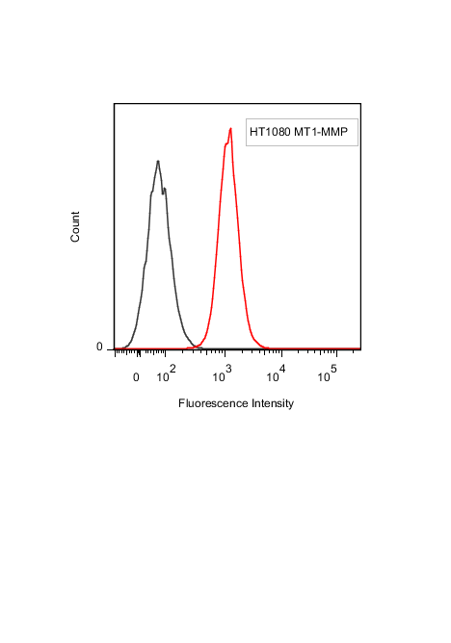
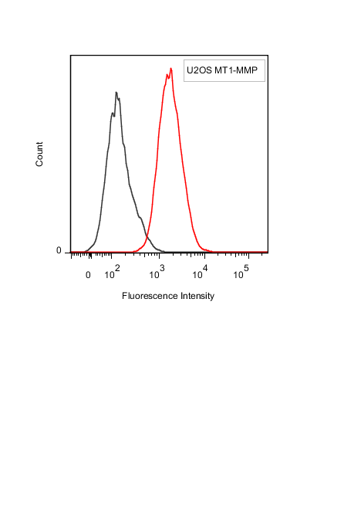
Breast carcinoma cell line
Fibrosarcoma cell line
Osteosarcoma cell line

Slide 22
NG2
MT1-MMP
Blood vessel
WBC
RBC
RBC
WBC
RBC
WBC
RBC
RBC
RBC
RBC
Sarcoma Cell
WBC
WBC
RBC
RBC
WBC
RBC
RBC
Millions of white blood cells
Billions of red blood cells
and only 5 to 100 sarcoma cells!

Slide 23


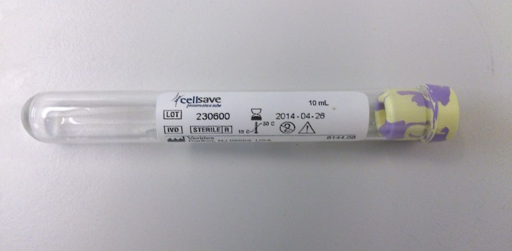
CTC Analysis in Human Blood Samples: Methodology
Flow cytometry to enumerate CTCs/ml
1ml whole blood
Antibody cocktail
WBC: CD45,CD16
Sarcoma: MT1-MMP & NG2
Red cell lysis
FACS Canto II
Stop at 1 million events
Notes:
Relies on use of antibodies against proteins specific to tumour- trialling NG2 and N-cad based on literature and MT1-MMP based on Kenny’s research
Were using vimentin (type III intermediate filament protein expressed in mesenchymal cells) but both intracellular and cell surface antibodies labelled cells non-specifically

Slide 24
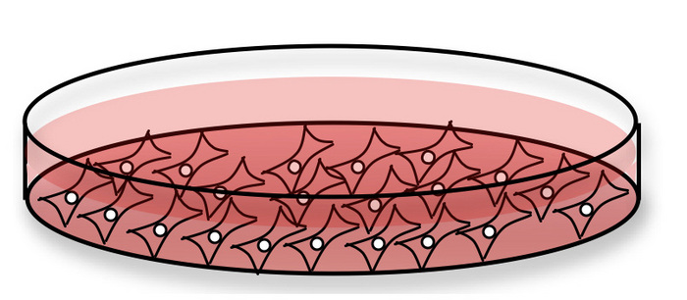
Volunteer blood
U2OS osteosarcoma
cells from a dish
Stain the cells for markers of white cells and our sarcoma biomarkers MT1-MMP and NG2
Flow cytometry to
count the number of cells
Red cell lysis

Slide 25
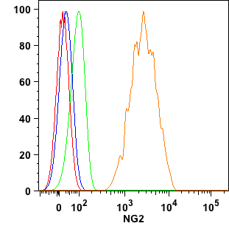
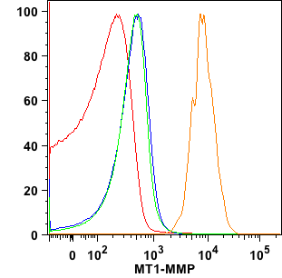

U2OS cells

Slide 26
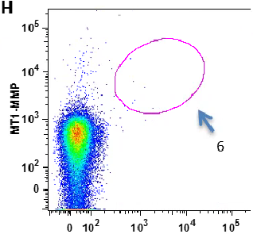
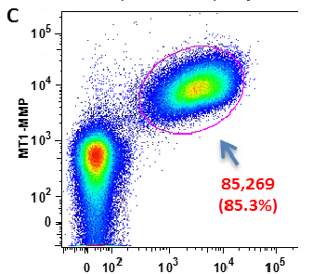
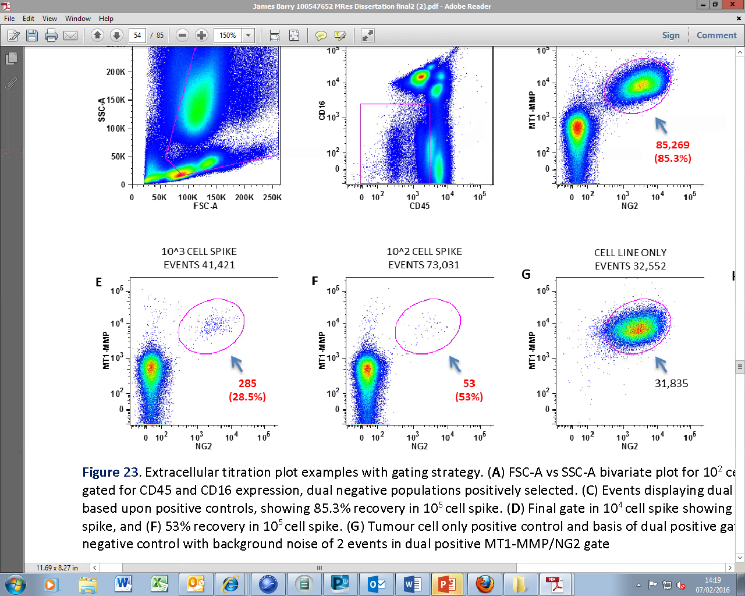
No spiked cells
100,000 U2OS cells
1,000 U2OS cells
100 U2OS cells

Slide 27
UK AND REPUBLIC OF IRELAND BONE AND SOFT TISSUE SARCOMA CENTRES
Aberdeen
Glasgow
4 patients
Edinburgh
12 patients
Newcastle upon Tyne
Belfast
Greater Manchester/Oswestry Service
Dublin
4 patients
Birmingham
Children’s Hospital
Oxford
London
UCLH
25 patients

Slide 28
ACCRUAL (3 year period)
Original target 30, Extended to 50.
Final achieved 45

Slide 29
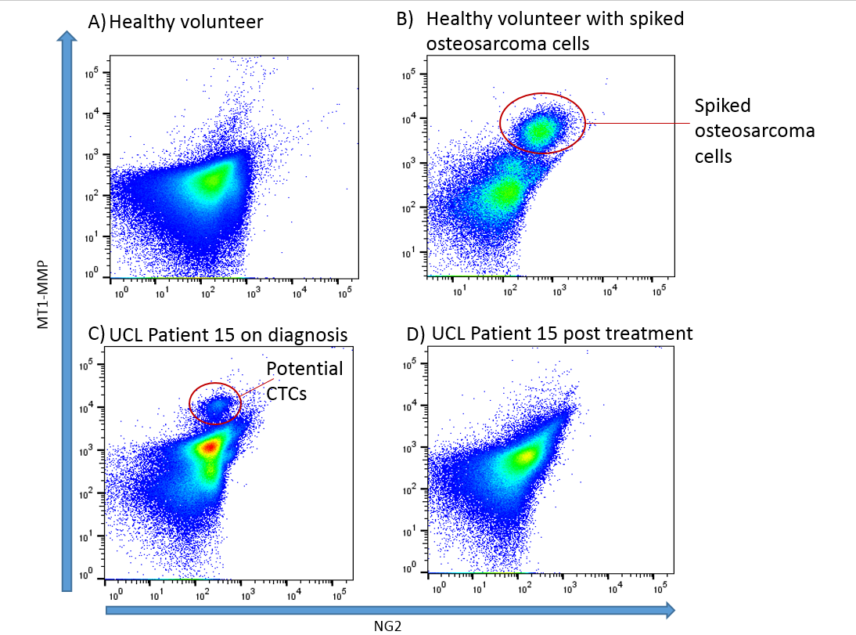
GATING- QUADRANTS
MT1-MMP
<5%
NG2
MT1-MMP
21%
NG2
MT1-MMP
14%
MT1-MMP
<5%
NG2

Slide 30
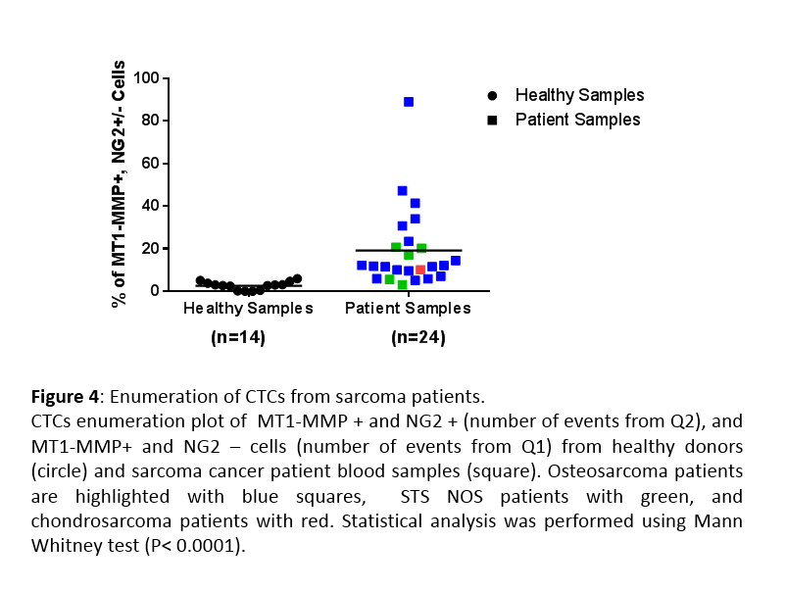
***
18 osteosarcoma, 5 soft tissue sarcoma, 1 chondrosarcoma
***p<0.001 (Mann Whitney U)

Slide 31
UCL Patient 16

Slide 32
Nucleic Acids
Messenger RNA
  Not stable
MicroRNA
Circulating tumour DNA

Slide 33
Exosomes in cells contain microRNA

Slide 34
Cancer cell is producing lots of microRNA143
Normal cell is producing some microRNA24
and a little microRNA143
microRNA24
microRNA24
microRNA143
microRNA143
microRNA24
microRNA143
microRNA143
microRNA143

Slide 35
Blood vessel
Millions of exosomes per ml of blood

Slide 36
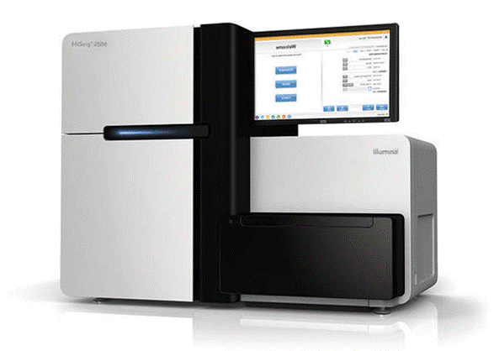
MicroRNA protocol
Whole blood
Sequencing
Spin to get the plasma
Exosome extraction kit

Slide 37
MicroRNA sequencing
Particular target e.g. microRNA143
Extensive sequencing to look for patterns

Slide 38
Circulating tumour DNA
Major progress in last few years
Clinical trials indicate this will become the mainstream liquid biopsy assay

Slide 39

Cell nucleus is full of DNA

Slide 40
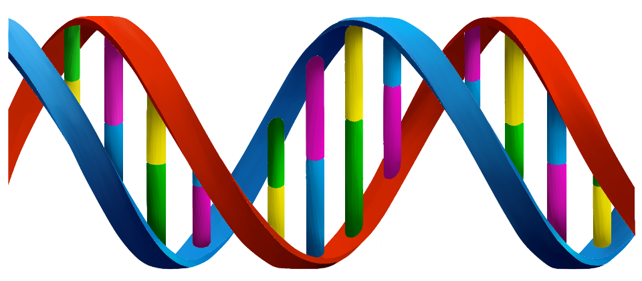
Normal cell DNA
Cancer cell DNA
Mutation

Slide 41
Blood vessel

Slide 42
Circulating tumour DNA protocol
Whole blood
Sequencing
Spin to get the plasma
DNA extraction kit

Slide 43
DNA sequencing
Particular target
  TP53 mutation
Whole genome sequencing
Exome sequencing

Slide 44
TracerX
Demonstrated that ctDNA can be detected in lung cancers
Evolution in ctDNA compared to the original tumour
Relapse predicted 6 months ahead in a few patients

Slide 45
Proteomics
Abnormal proteins shed into the bloodstream
Relies on mass spectrometry
p53 isoforms may be detectable

Slide 46
Transferability to LFS
There is preclinical evidence that as tumours form, the relevant mutations can be detected in the form of ctDNA in the blood
https://cancerres.aacrjournals.org/content/77/13_Supplement/2741
Mice implanted with rhabdomyosarcoma, osteosarcoma and lung carcinoma

Slide 47
Routine baseline C-RP, Alk Phos, Albumin
ctDNA baseline assessment
Sequencing for more detail to document the mutational profile
LFS confirmed
MicroRNA sequencing
CTC assessment
Tissue and circulating p53 isoforms

Slide 48
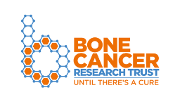
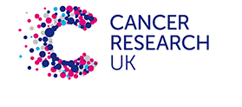
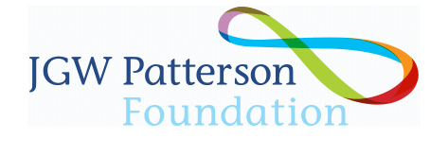
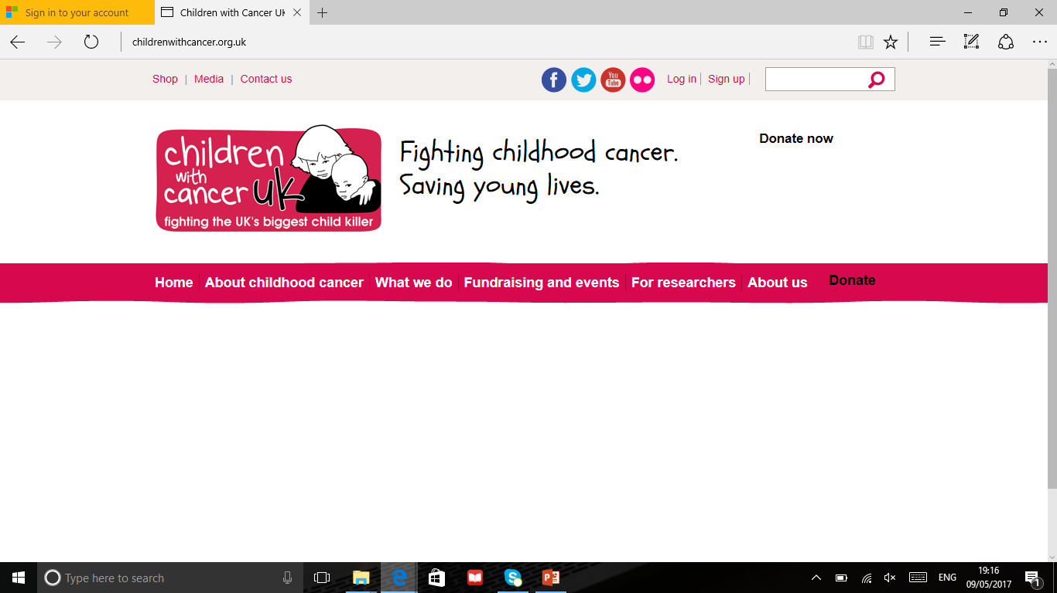
Acknowledgements
Kate Rennie, PhD
Emma Haagensen, PhD
James Barry, Mres
Lysander Gourbault, Mres
Healthcare Charity

