Slide 1
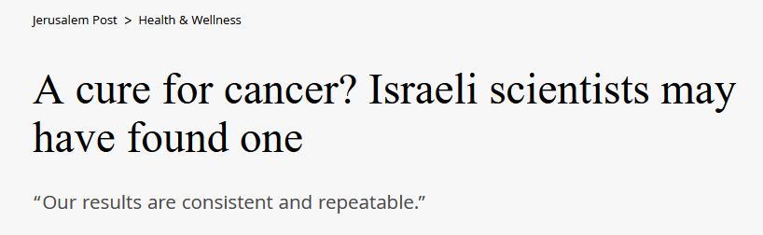
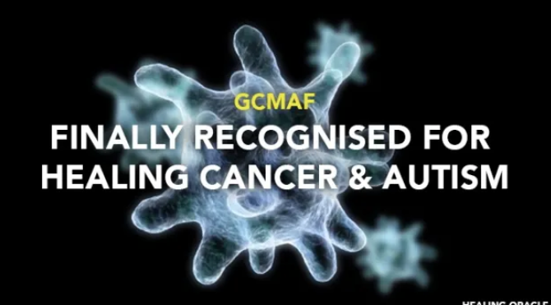
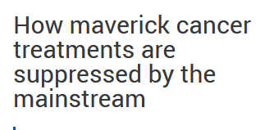

Frauds, Fakes and Miracle Cures
Navigating the minefield
Pan Pantziarka

Slide 2
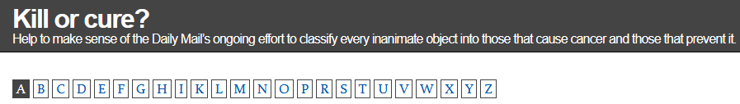
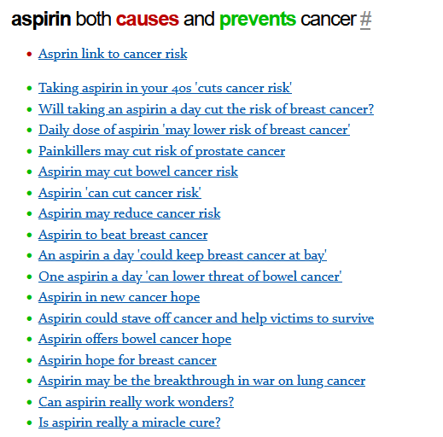
Common Themes
X cures cancer
  X = cannabis, curcumin, vitamin C, chlorine dioxide, special diets…
Y causes cancer
  Y = microwaves, mobile phones, the wrong diet, vitamin C…
Z prevents cancer
  Z = cannabis, super-foods, aspirin, exercise

Slide 3
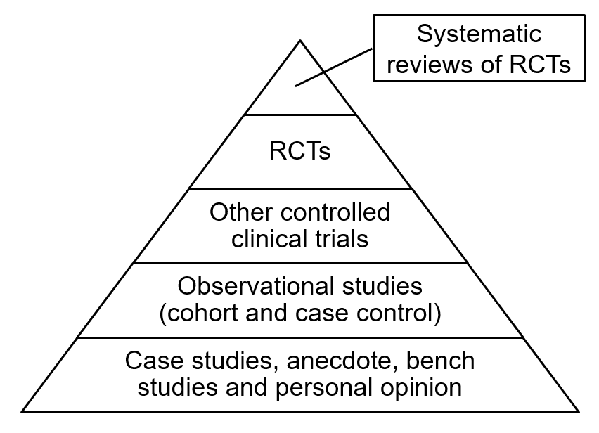
Evidence?
The first question to ask is always ‘where’s the evidence’?
This applies whether the story comes from a tabloid, a posh paper, the BBC or even a scientist
If a story sounds too good to be true then alarms bells should be ringing!
Randomised Controlled Trial
Most stories in the press aren’t even in the bottom level of the pyramid

Slide 4
Substance X cures cancer…
These stories mostly come in two types
  Personal anecdote – someone with cancer was cured because they used a certain supplement, food, life-style etc
  Laboratory story – cancer cells or mice with cancer were cured with a certain chemical or food
In both cases the idea is that a complex disease like cancer can be cured by the addition of a single substance
Digging into the personal anecdotes usually shows the person had lots of other treatments – including standard chemo, radiotherapy etc
In some cases these stories are faked from beginning to end – there was no cancer to begin with!
The laboratory stories are not more trustworthy because they’re published by scientists. Just about everything kills cancer cells in a petri dish!
Remember – people are not mice! Many lab mice are not a good model for real cancers
These stories are below or on the lowest rung of the evidence pyramid

Slide 5
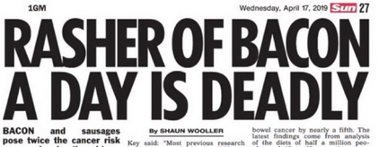
Substance X causes cancer
This is a very popular story in the media – usually with alarming headlines to add to your stress levels
Often based on scientific studies which track large populations to see if a given food, life-style, star-sign or something else is associated with increased cases of cancer
Beware of how stats are reported – relative risk is not the same as absolute risk

Slide 6

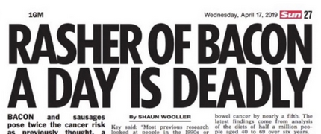
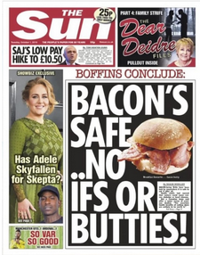

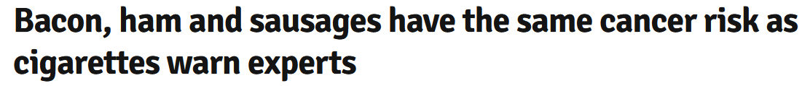
Relative risk vs. Absolute risk
Source: BBC website
A fast read of these articles can make you think that eating a couple of extra rashers of bacon a day raises your risk of bowel cancer to 20%
The overall risk of bowel cancer in the UK is actually 6% - raising that by 20% makes it 7.2%
So out of 100 daily bacon eaters, we would expect 1 extra case of bowel cancer in their lifetimes
Always look at how these risks are phrased! Most alarming headlines turn out to be fairly boring once you look at absolute risks

Slide 7
Substance X prevents cancer
There are two common sources for these stories
  Laboratory studies in mice
  Observational studies in people
Repeat after me: A lab mouse is not a good model for a human
  These studies might be useful for generating new research ideas but not as a basis for life-style advice for people
Observational studies are based on comparing different groups of people to see if they differ in cancer incidence
  How can you tell that the two groups are really comparable? Again – possibly useful as a staring point for more research
These studies are low on the pyramid – but can feed in to the design of clinical trials

Slide 8
Red flags: Conspiracy theories
The idea that governments and ‘Big Pharma’ have a cure for cancer and are keeping it hidden is very common on some alternative medicine websites and forums
Of course it’s not such a secret that people running these sites know about it – and will often sell you the cure for vast sums of money
Treatments should be assessed on the basis of evidence – but making up conspiracy theories helps explain a lack of evidence
Often include attacks on current treatments – and sometimes urge people to stop or delay their treatment because it interferes with whatever ‘cure’ they are selling
Nobody is saying that pharma companies are squeaky clean – but if a cure really existed think how much fame and money would result, it would make every other drug success pale into insignificance!
Conspiracy theories are designed to sow doubt not to enlighten

Slide 9
Red flags: Selling product
Lots of alternative treatments are linked to specific supplements and supplement companies
It’s not just supplements and drugs – there are all kinds of expensive devices and gadgets out there claiming to treat or prevent cancer
Beware of scientific sounding evidence used to sell these products – remember there’s a huge chasm from a study in a test tube to treating a real cancer
Faked ‘studies’ or lists of hundreds of papers proving a treatment works are designed to blind with science rather than to genuinely enlighten you
It’s a sad fact but there are lots of people only too willing to fleece desperate cancer patients and their families

Slide 10
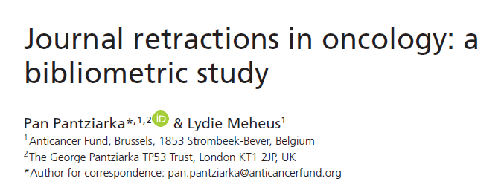
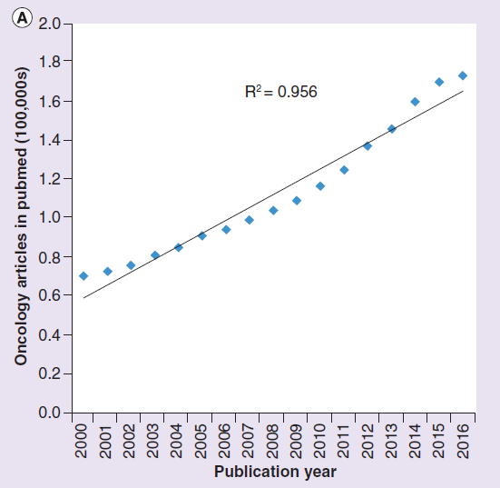
Red flags: Trust THE SCIENCE
Scientists are people too – they can exaggerate, lie, cheat, and do all the things that everyone else does
Fake data and outright fraud are real problems, even in oncology
Fake journals (known as predatory journals) are a growing problem
Anyone who talks about ‘The Science’ is either a politician or someone looking to appeal to authority
Scientists can hype up results as much as anyone else!

Slide 11
Red flags: Cure-alls
Cancer is a set of over 200 diseases – no single treatment is ever likely to treat all of them
Be sceptical of anything claiming to be the CURE!
A drug that can treat all cancers and a ton of other diseases is closer to magic than to a real medicine

Slide 12
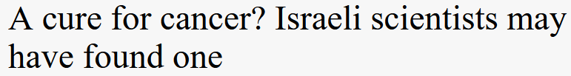

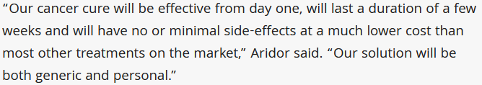

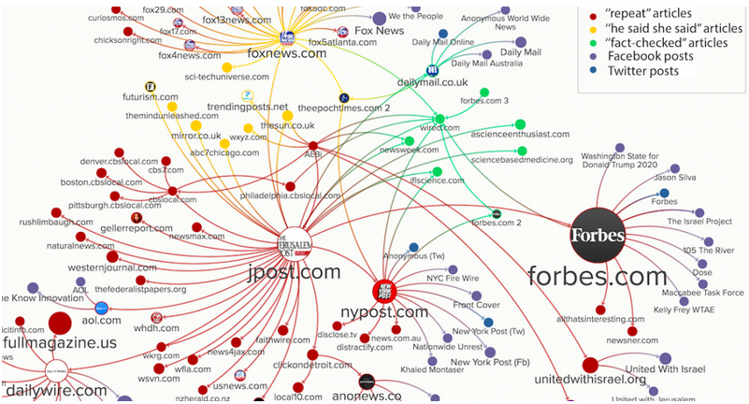
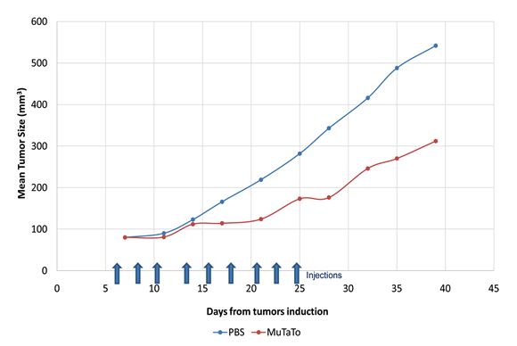
A case study
Conclusion: HYPE!!

Slide 13
The Golden Rules
Stay sceptical!
Check multiple sources for information
There is no such thing as ‘The Science’ – science is an evolving process not a fixed body of facts or a set of institutions
Remember – people are not mice!
Keep the pyramid of evidence in mind – most media stories don’t even get onto the bottom rung
Remember: extraordinary claims require extraordinary evidence
Finally – this doesn’t mean everything you ever read is wrong! It just takes some work to find the evidence

