Slide 1


Can we reduce cancer incidence in TP53 related LFS?
Prof D Gareth Evans MD FRCP
University of Manchester
On behalf of Sarah Blagden and Gareth Bond

Slide 2
Background
Li-Fraumeni syndrome (LFS) is a rare inherited cancer predisposition syndrome
It affects between 1/5000 to 1/20000 people, in UK approximately 5,500 although only 500 have been diagnosed with it
LFS is caused by germline pathogenic variants in TP53, a tumor suppressor gene.
Lifetime risk of cancer =90% by age 60 years.
Half of women with LFS will develop a cancer by age 31 years and half of men by age 46 years.
Typical “core” cancer types include: bone and soft-tissue sarcomas, pre-menopausal breast cancer, brain tumors and adrenocortical carcinomas.
While cancer surveillance has been shown to be successful in early detection of cancers in LFS, cancer prevention in individuals with LFS has thus far been unexplored.

Slide 3
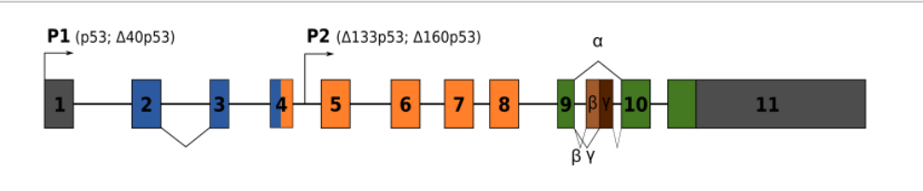
Tp53
(chrom 17p)
Majority of pathogenic mutations are missense mutations in exons 5-8 – DNA binding region
P53 responds to genomic instability by:
Inhibiting metabolism
Inducing cell cycle arrest
Inhibiting angiogenesis
Inducing cell death
Inducing senescence

Slide 4
Tp53
(chrom 17p)
mutated
P53 responds to genomic instability by:
Activating metabolism
Preventing cell cycle arrest
Activating angiogenesis
Preventing cell death
Preventing senescence
tumorigenesis

Slide 5
Current screening pathway for a LFS patient - UK
Yearly breast MRI 20-50y
Yearly mammogram from 50
MRI-b
MRI-b
MRI-b
MRI-b
MRI-b
MRI-b
MRI-b
MRI-b
MRI-b
Surgery: Bilateral mastectomy and reconstruction.
20 y
50 y
25 y
No whole body MRI –study recently published (Saya et al, 2017) showed benefit and current discussions underway
No chemoprevention has been assessed

Slide 6
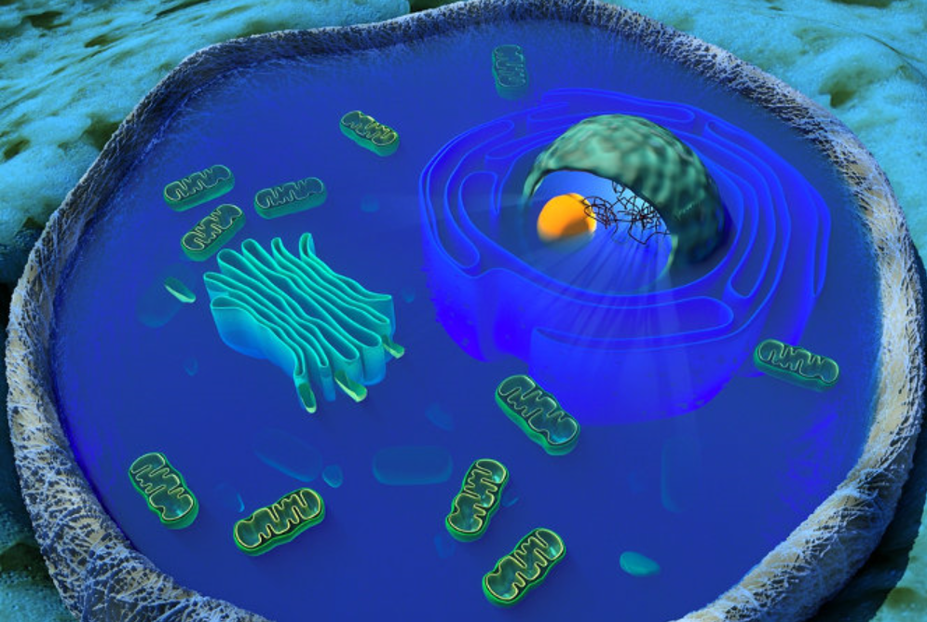
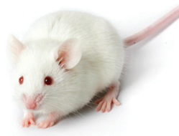
Mutant P53 activates metabolism by increasing mitochondrial function and oxidative phosphorylation
Seen in mice and LFS patients (NEJM 368(11):1027-32, 2013).
Mouse model of LFS with mtDNA mutations (Polg^{mut}/p53^{172H/H}) – LFS mice lived 2x longer if had mitochondrial mutations. This was reproduced by metformin
STOP
STOP
STOP

Slide 7
Mutant P53 activates metabolism by increasing mitochondrial function and oxidative phosphorylation
Metformin inhibits oxidative phosphorylation in mitochondria
STOP
STOP
STOP

Slide 8
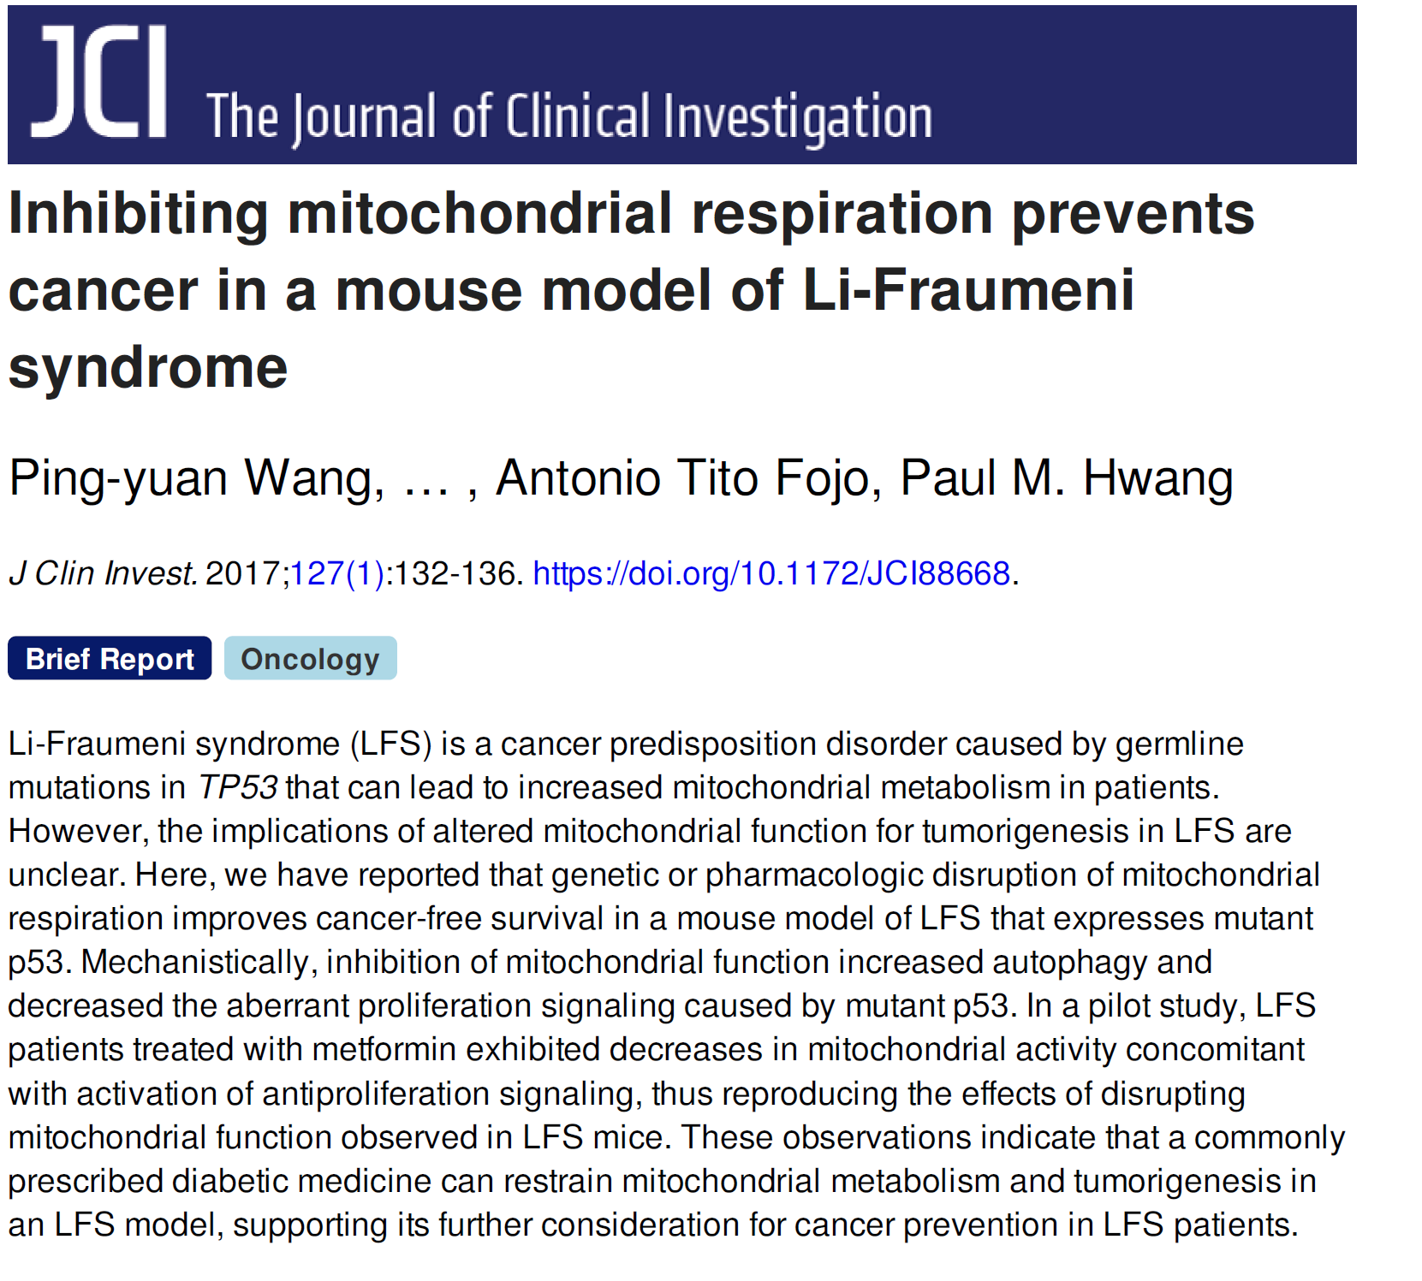

Slide 9
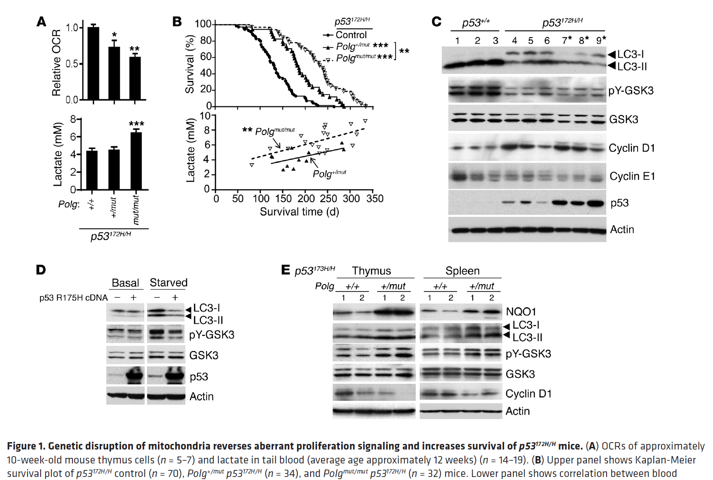

Slide 10
Why metformin?
Metformin is an oral glucose-lowering agent that has been used to treat type 2 diabetes for the last 60 years.
At a cellular level, metformin works directly in mitochondria: activating AMPK, increasing glycolysis and inhibiting oxidative phosphorylation.
In normal cells, this lowers glucose production (and hence reverses diabetic hyperglycaemia).
Metformin also has known anti-cancer properties because it reverses the “Warburg effect” whereby cancer cells increase oxidative phosphorylation to induce tumour progression.
In a paper in NEJM in 2013, Paul Hwang and team showed that mitochondrial function was pathogenically elevated in tissue from patients (and mouse models) with LFS.
In a subsequent publication in 2017, his team demonstrated that metformin restrained tumorigenesis and mitochondrial metabolism in an LFS model. This led to an NCI-funded pilot study in 21 LFS patients whereby metformin intake caused a correction in mitochondrial function (ASCO, 2017

Slide 11
Why metformin?
As a result of this, the NCI are currently developing a larger prospective, randomised study of metformin patients with LFS. In order to sufficiently power this study, the NCI team have grouped with teams from Canada, UK and Australia to form Module 1 of the Modular LFS study.
As well as addressing the benefit of Metformin at preventing the emergence of cancer in LFS patients, the study centres will explore the biology of the disease using novel sequencing and mitochondrial function assays to provide greater understanding of the links between aberrant TP53 function and tumour metabolism. A positive outcome from Module 1 would be Accelerated Approval of Metformin in patients with LFS.

Slide 12
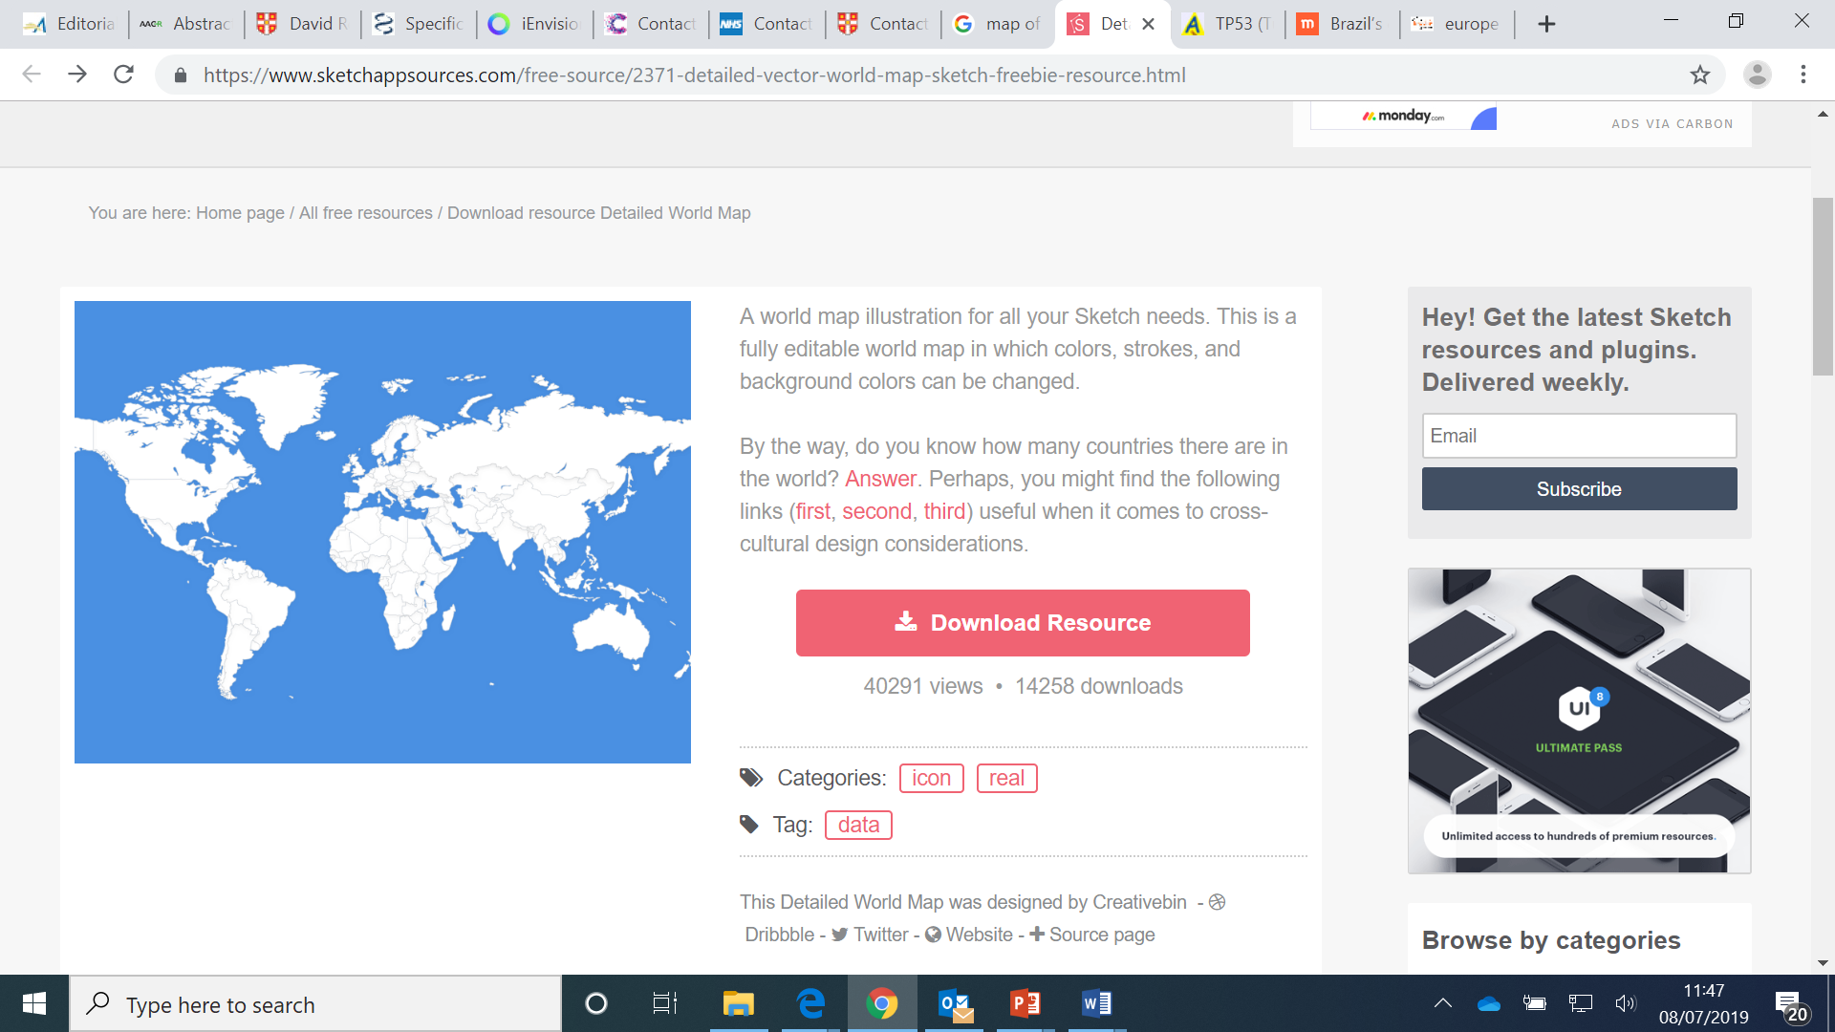
The MILI study - an international initiative
UK: Oxford, Sarah Blagden, Gareth Bond
Manchester: Gareth Evans
London: Helen Hanson
Canada: David Malkin
USA: NCI, Payal Khincha, Sharon Savage, Paul Hwang
Australia: David Thomas, Mandy Ballinger

Slide 13
Module 1 (500 pts)
Linked translational work
NCI – FLEX metformin study
Dose-finding, PBMCs, circulating markers, gut microbiota, mitochondrial DNA
Outcome
UK - MILI randomised metformin study
Mitochondrial functioning in PBMCs, P53 variants and outcome, circulating biomarkers, PET substudy
Fast-tracked approval for metformin as Standard of Care
Australia randomised metformin study
TBA
Canadian pediatric randomised metformin study
TBA
Modules 2 onwards
Phase II of drug X
Collaborative phase III study of drug X
Linked translational work
Fast-tracked approval path
Sarah Blagden – Oxford ECMC

Slide 14
Module 1 -LFS Study:
For Module 1, we aim to enroll 500 participants with “true” LFS - i.e. those carrying pathogenic TP53 mutations. They will be identified through regional genetics clinics. Participants will be randomized 1:1 to metformin or patients’ choice (aspirin, multivitamins etc). Those in the active arm will remain on metformin for up to 5 years. Patients will undergo yearly whole body and brain MRI (now standard of care) and colonoscopies as well as regular serological, haematological and toxicity assessments. A primary objective will be comparison of cancer incidence within 2 years in investigation (metformin) versus control (patients’ choice) arms of study. Cancer incidence at later timepoints, disease-free and overall survival and health economic endpoints are included.

Slide 15
Aims and objectives
The aim of Module 2 is to evaluate whether metformin is better than
participant’s choice at preventing or delaying the onset of cancer in
people with Li Fraumeni Syndrome bearing class 4+ pathogenic mutations.
 | Objectives | Endpoints
Primary | Cancer incidence within 2 years in investigation (metformin) versus control (participant’s choice) arm of study | Number of scan-detected or clinically-detected cancers identified during study participation within 24 months of randomisation (this does not include cancers detected at baseline)

Slide 16
Aims and objectives
Secondary | Cancer incidence within 5 years in investigation (metformin) versus control (participant’s choice) arm of study | Number of scan-detected or clinically-detected cancers identified during study participation within 60 months of randomisation (this does not include cancers detected at baseline)
 | Cancer-free survival in metformin versus participant’s choice arms | Time from randomisation to cancer diagnosis

Slide 17
Inclusion criteria
Patients who meet all of the following inclusion criteria will be considered eligible for this study:
1) Known, genetically-confirmed Li Fraumeni Syndrome with pathogenic p53 mutation
2) Capable of giving written informed consent, which includes compliance with the requirements and restrictions listed in the consent form.
3) Aged above 18 years.
4) Able to swallow and retain oral medication.
5) Adequate organ function as defined below. Including eGFR >50 mL/min
6) Absence of serological or radiological evidence of malignancy or recurrence of prior malignancy

Slide 18
Exclusion criteria
Patients who meet any of the following exclusion criteria will not be considered eligible for this study:
1. Diagnosis of Li Fraumeni-like syndrome or positive risk by Chompret Criteria in the absence of pathogenic p53 mutation
2. Current pregnancy or breast-feeding
3. Currently taking metformin, phenformin or other hypoglycaemic agents (e.g. gliclazide or insulin) for diabetes or other indications
4. Evidence or history of diabetes mellitus
5. Evidence or history of cardiac failure and/or myocardial infarction
6. Previous randomisation into the present study
7. Presence of active gastrointestinal disease or other condition that could affect gastrointestinal absorption (e.g. malabsorption syndrome) or predispose a subject to gastrointestinal ulceration.
8. No serious medical condition other than Li Fraumeni Syndrome that is likely to result in a life expectancy of less than 5 years

Slide 19
Procedure | -14 to 0 (Screening) | C1 D1¹ | C1 D15¹ | C2 D1¹ | C2 D15¹ | 3 Monthly review from C3 onwards for 6 months | 6 monthly review for up to 5 years | EOS
Informed Consent | x
Eligibility checklist | x
Medical History | x
Physical Examination | x |  |  |  |  | X | x | x
ECOG Performance Status | x | x | x | x | x | x | x | x
Haematology & Biochemistry² | x | x | x | x | x | x | x | x
Whole Body MRI³ | x |  |  |  |  |  | x
Brain MRI³ | x |  |  |  |  |  | x
Colonoscopy³ | x |  |  |  |  |  | x
Dermatological examination | x |  |  |  |  |  | x | X
Adverse Events⁴ | x | x |  |  | x | x | x | x
Concomitant Medication | x | x |  |  | x | x | x | x
Blood sample –PD | X |  |  |  | X | x | x
Administration of metformin |  | X (500 mg od) | X (increase to 500mg bd) | X (increase to 1000mg od) | X (increase to 1000mg bd) | x | X
QOL questionnaire | X |  |  |  |  |  | X | X
Whole body MRI will be conducted yearly as SOC (we hope), Colonoscopy alternate-yearly and yearly dermatological review

Slide 20
Progress and Plans
July 2019: Presented UK Therapeutic Cancer Prevention Network Group (UKTCPN) who gave it their blessing
To be submitted to CRUK’s Clinical Research Committee in the autumn (to seek funding)
We are waiting to hear whether whole body MRI has been approved as standard of care in NHS. An application by Gareth Evans was sent in but we don’t yet know the outcome. Without this, we will be unable to run the study as the costs would be massive
David Malkin has submitted the paediatric Canadian version of this study for funding from a Canadian Charity called CureSearch – decision pending. The USA (adult) study has funding from NCI but they are reworking the trial design. We are waiting to get this from them as we are keen to make it as similar as we can to theirs so we can pool the data.
PPI group via George Pantziarka TP53 Trust

