Slide 1
My Story -
How I was saved by the Signified
Study
Nina Irwin
9th September 2023

Slide 2
Background
First breast cancer 1993 aged 40
Sister tested for BRCA gene – “Why not just tick all the boxes ?”
My second breast cancer 2016 LFS test
Enter Prof Eeles and Royal Marsden
Hysterectomy 2017 found precursor to ovarian cancer
Joined Signified Study summer 2022

Slide 3
Lung cancer
First Signified MRI in August 2022
“There is something there” behind right shoulder
Diagnostic tests and lung biopsy
You have lung cancer

Slide 4
Cure
Surgery October 2022 removed small lung tumor
Stage 1 cancer, no spread, no lymph nodes
Believe cured
The Signified Study saved my life

Slide 5
One Year Later
Second MRI August 2023
“There is something there”
Urgent investigations
Active nodule, lower abdomen, attached to artery
? Sarcoma
Small but hard to get at
Surgery 3rd October
My Story is ongoing

Slide 6
Is My Story really
How I was saved by the Signified
Study --- ? Twice ?

Slide 7
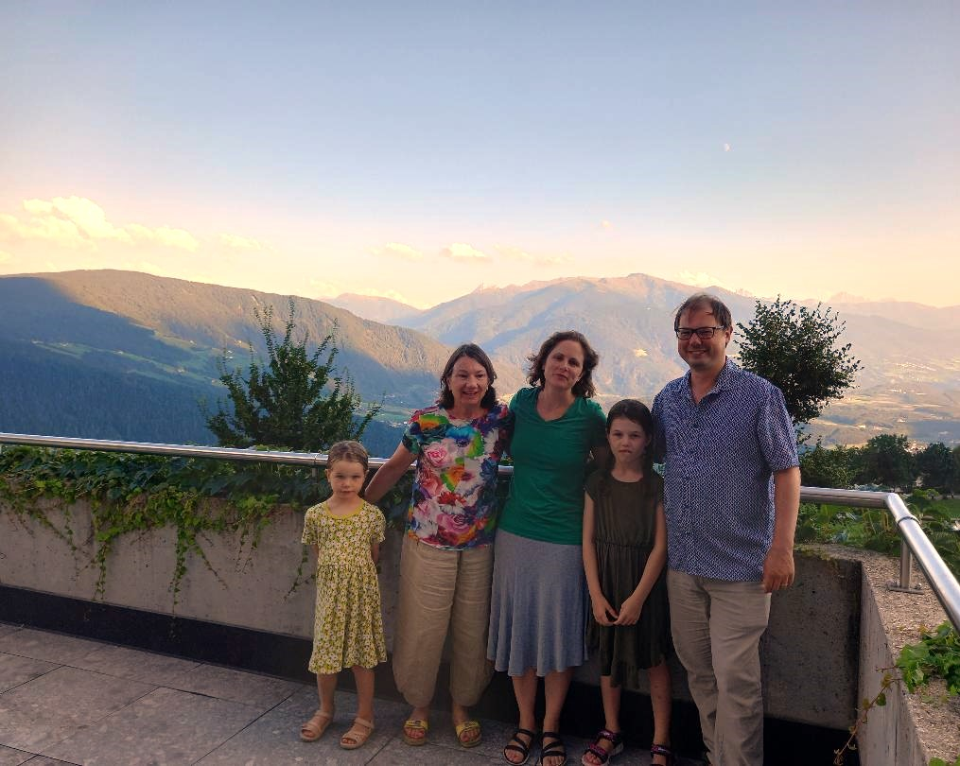
Huge Thank You to Elena, Ros Eeles, GP TP53 Trust, Royal Marsden

